Slide 1
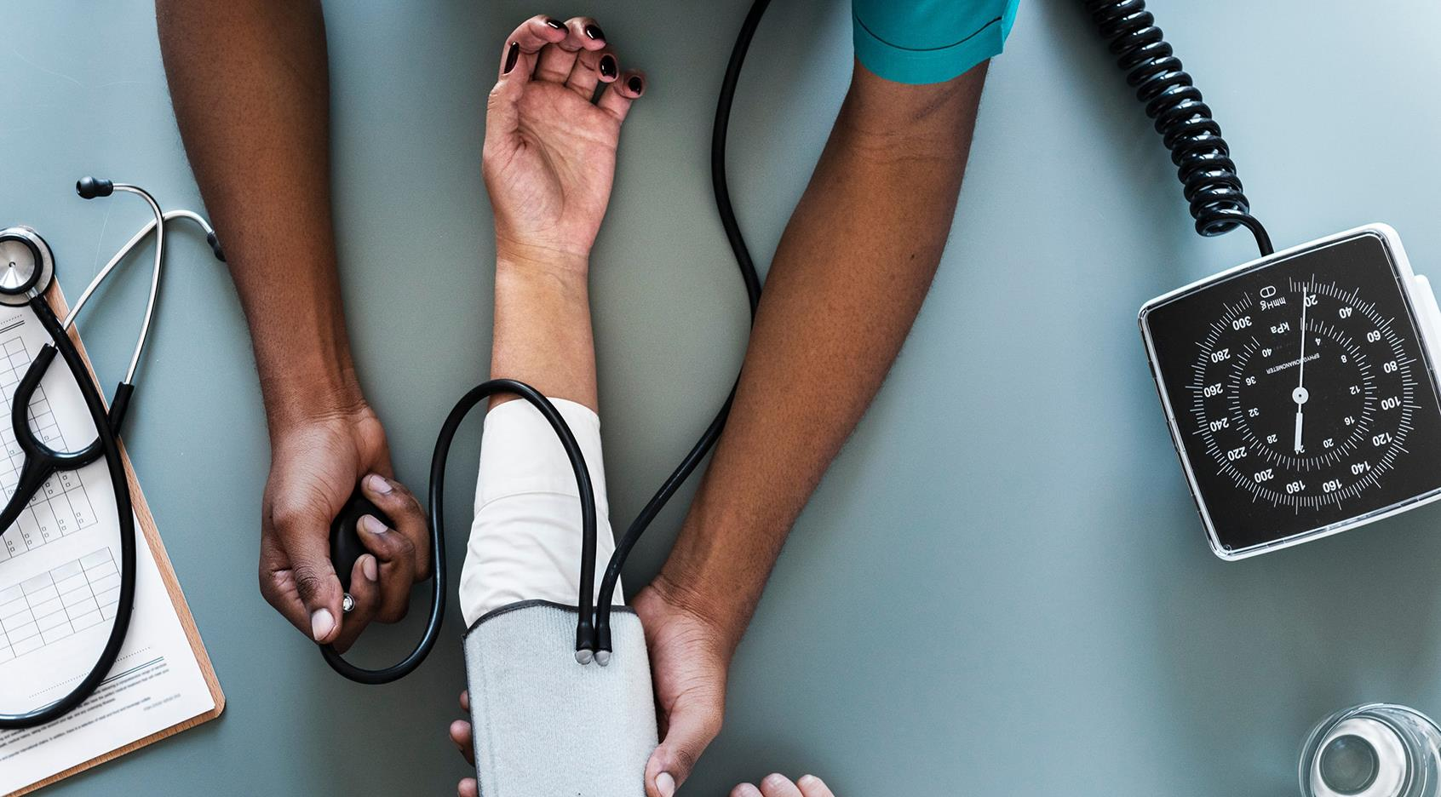
Multiple Disease Detection System (Skin Cancer & others)

Slide 2
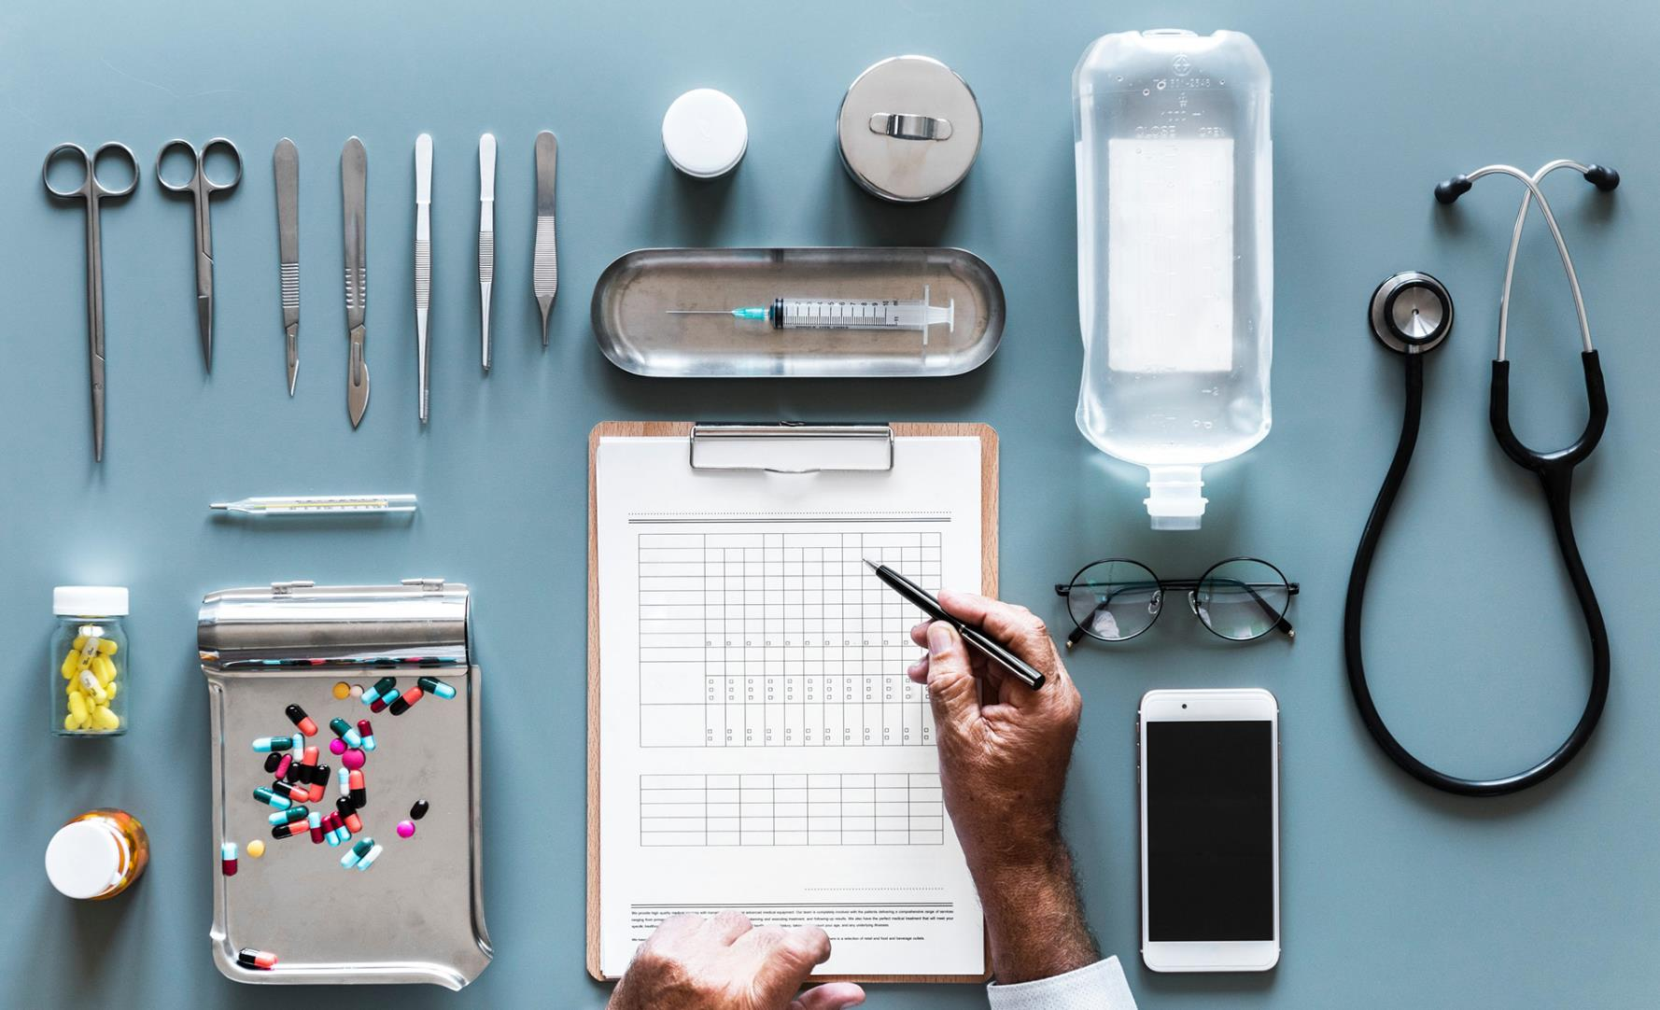

Problem Statement
The healthcare industry faces challenges like delayed diagnosis and limited access.
The "Multiple Disease Detection System (skin cancer & others)" project, utilizing deep and machine learning, offers a transformative solution. By accurately identifying diseases from user-provided symptoms, it shifts healthcare towards proactive management.
This early detection improves patient outcomes, reduces costs, and relieves healthcare strain. Incorporating medication suggestions enhances personalized care.
This project embodies the industry's move towards precise, accessible, and efficient healthcare solutions..

Slide 3

About the project
Using Machine learning, our project proposes disease prediction system. For small problems, the users have to go personally to the hospital for check-up which is more time consuming.
Also handling the telephonic calls for appointments is quite hectic. Such a problem can be solved by using disease prediction application by giving proper guidance regarding healthy living
Thus, in this system, we are concentrating on providing immediate and accurate disease prediction to the users about the symptoms they enter along with the severity of disease predicted.
Best suitable algorithm and doctor consultation will be given in this project.
A web/android application is deployed for user for easy portability, configuring and being able to access remotely where doctors cannot reach easily, this project also looks forward to providing medicine and drug consultation of disease predicted. Therefore, this arrangement helps in easier health management

Slide 4

Software Resources Required
1. Operating System :- Android 7.0
2. IDE :- Android Studio
3. Programming Language :- Java

Slide 5
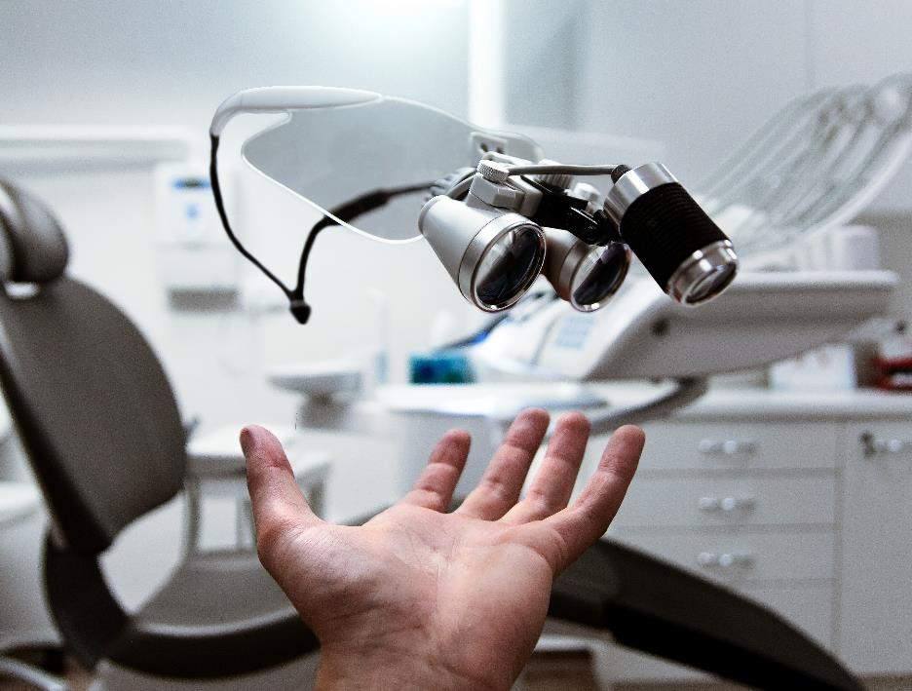
Goals
1. Accurate Disease Detection
2. Early Diagnosis
3. User-Friendly Interface
4. Comprehensive Health Assessment
5. Personalized Medication Suggestions
6. Education and Awareness

Slide 6
Objectives 1. Develop Deep Learning Models 2. Create a Database 3. User Input Interface 4. Integration of Machine Learning Algorithms 5. Personalized Recommendations 6. Educational Resources 7. Testing and Validation 8. Continuous Improvement

Slide 7
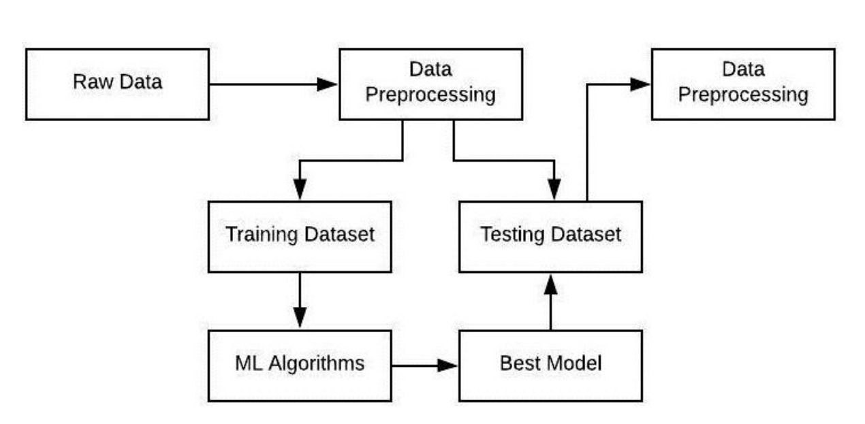

ML MODEL ARCHITECTURE

Slide 8
Statement of scope
This project’s scope encompasses the development and implementation of a Java-based mobile application designed to address critical challenges in disease detection, with a primary focus on skin cancer, heart disease, diabetes,and Parkinson’s disease.
The application will utilize state-of-the-art deep learning and machine learning techniques to accurately analyze user-input symptoms and provide early, reliable predictions.

Slide 9





Benefits
User Friendly
Financial
Trust
Cost of making
Efficiency
Easy to handle and simple user interface.
Cost-effective as can be accessed from home.
Assessed using various datasets.
Investing some hours and skills.
Efficient to detect disease.

Slide 10
Application
With the advancement in technologies and mobile phones being the most used user-friendly device, our team has come with an application that provides a prediction of the most caused lifestyle diseases like diabetes, skin cancer, and parkinson,s diseases at your hand. Disease predictor allows you to make important predictions about an ongoing but unknown disease with a few pieces of information like symptoms and diagnostic reports. It also helps you to have an in-depth knowledge of the symptoms, causes, and other important factors for future reference.

Slide 11
MOTIVATION OF THE PROJECT
The escalating global health challenges, compounded by delays in disease detection and limited accessibility to advanced diagnostics, serve as the drivingforce behind our endeavour.
Our motivation is rooted in the belief that everyone, regardless of their background or location, deserves timely and accurate health assessments.
This project is not just about technology; it’s about the lives we can positively influence, the barriers we can break, and the transformative journey towards a future where healthcare is truly accessible, personalized, and empowering for all.

Slide 12

Future Prospects
With this time and regular busy schedule of the people, they find it difficult to make it to hospital or clinics to consults physicians for a regular checkup. Here is where we play an important role in helping people with home-based solutions. When collaborated with certified and qualified doctors the prediction and data produced as output become more accountable and flexible. With a vast amount of diverse data available over the internet, it's very obvious for people to confuse in choosing the correct piece of information. But with our app, this problem gets an easy solution.

Slide 13
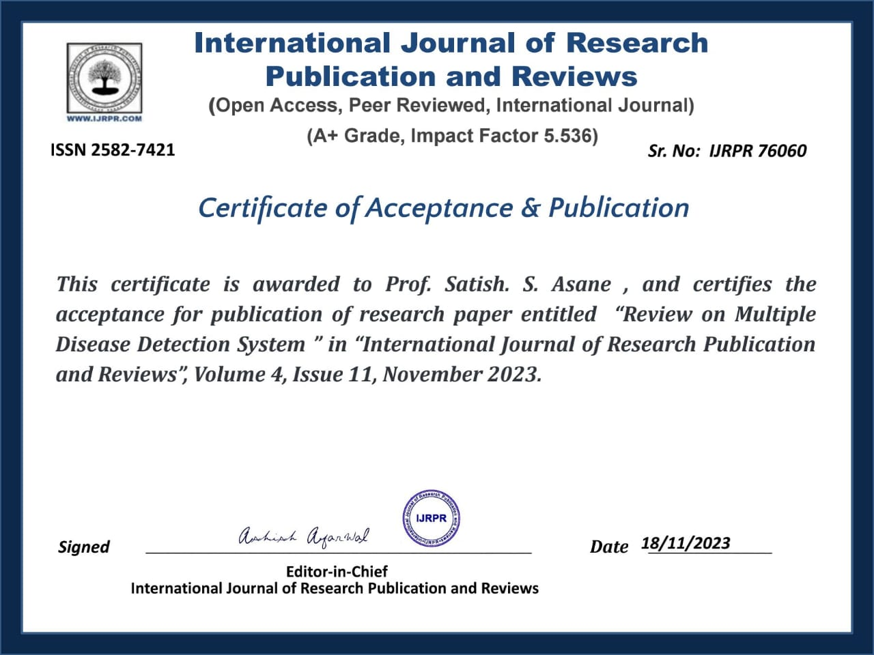

Slide 14
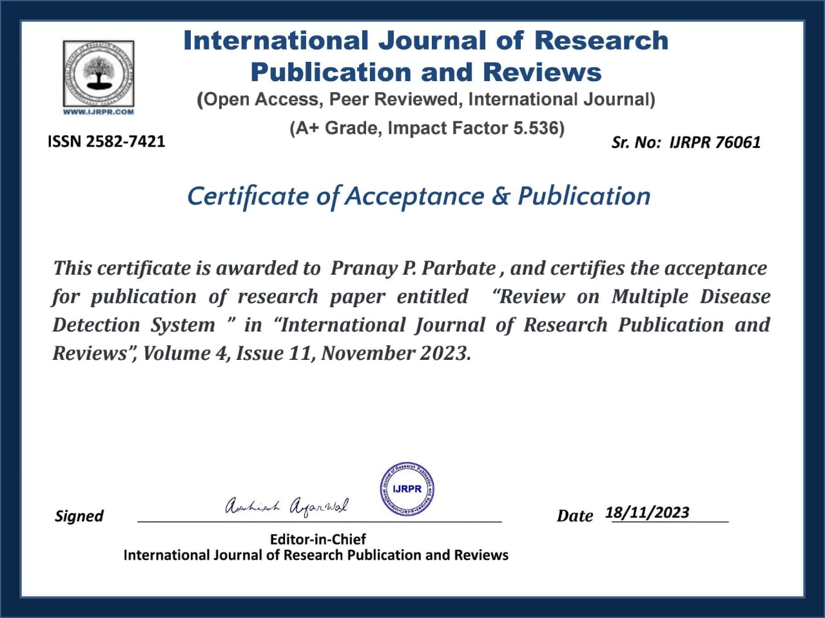

Slide 15
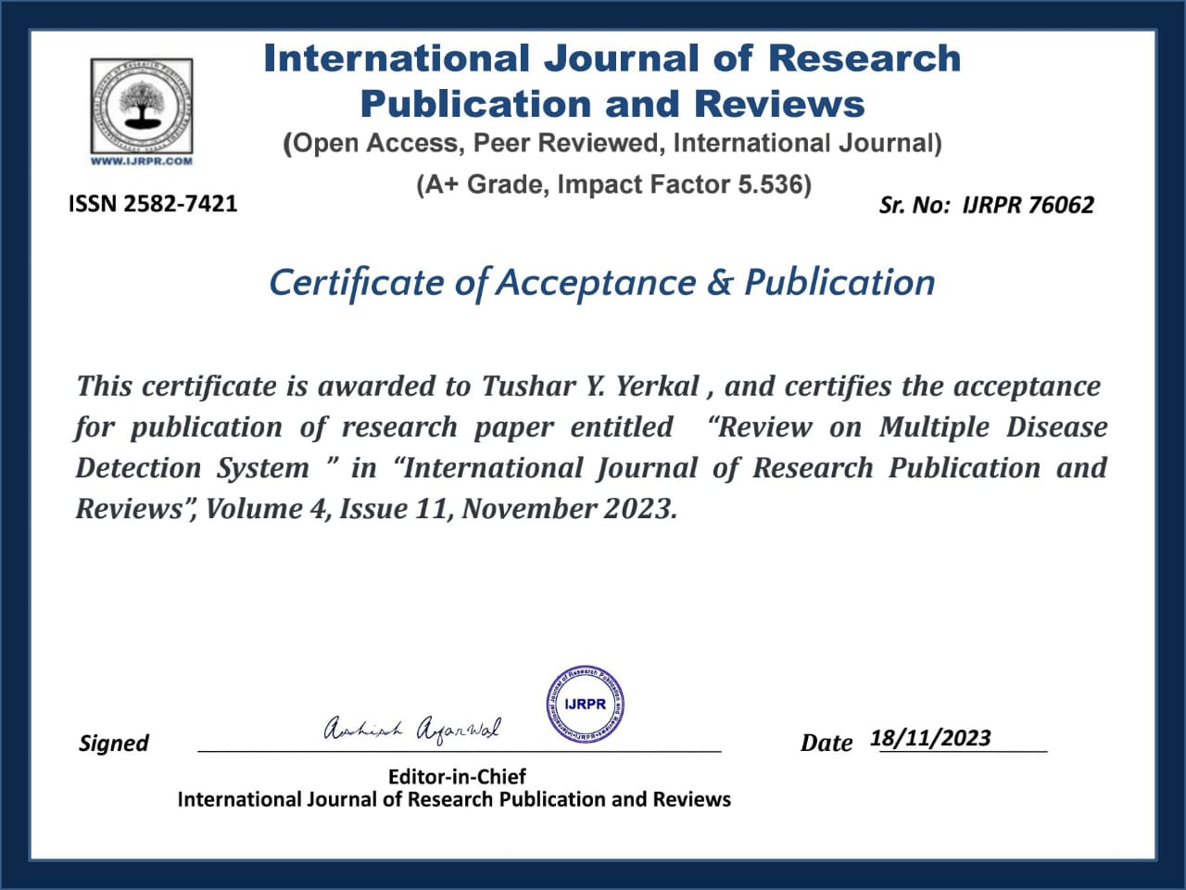

Slide 16
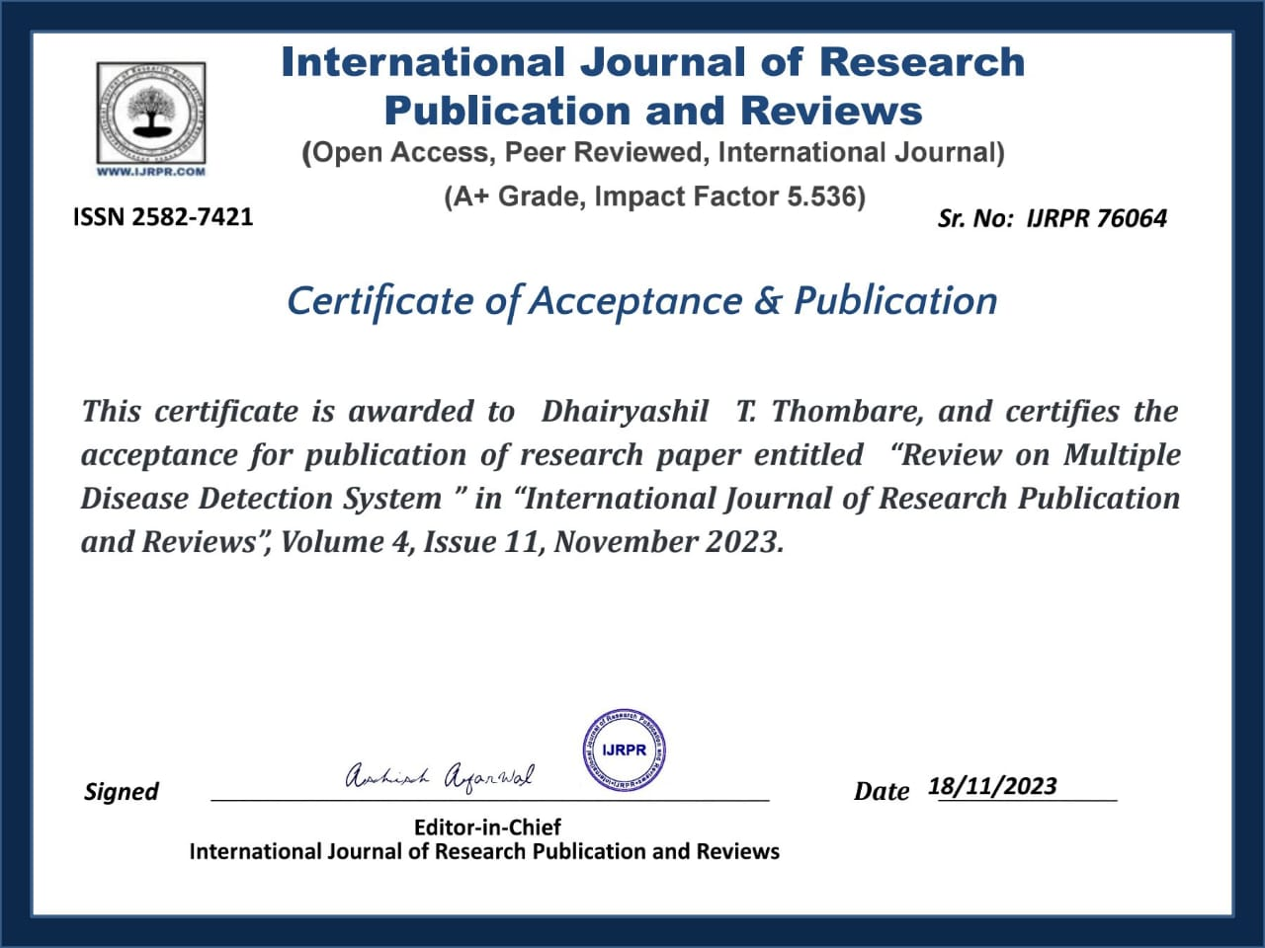

Slide 17


Slide 18
Thank You

